Slide 1

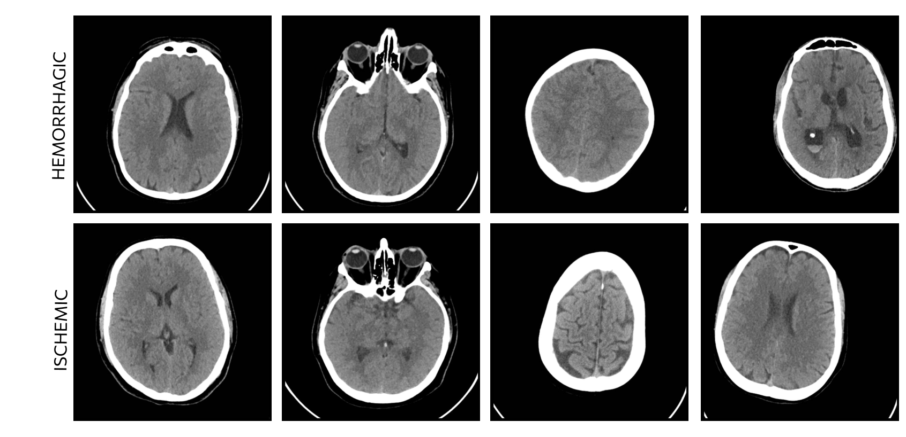
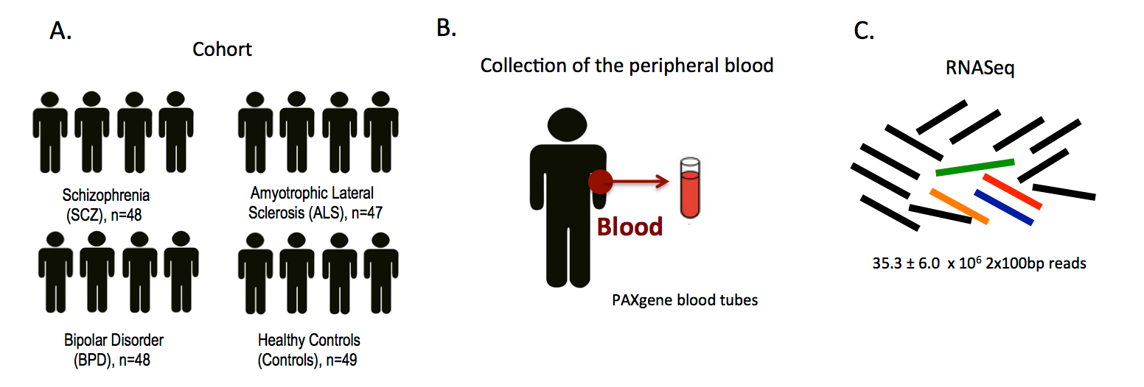
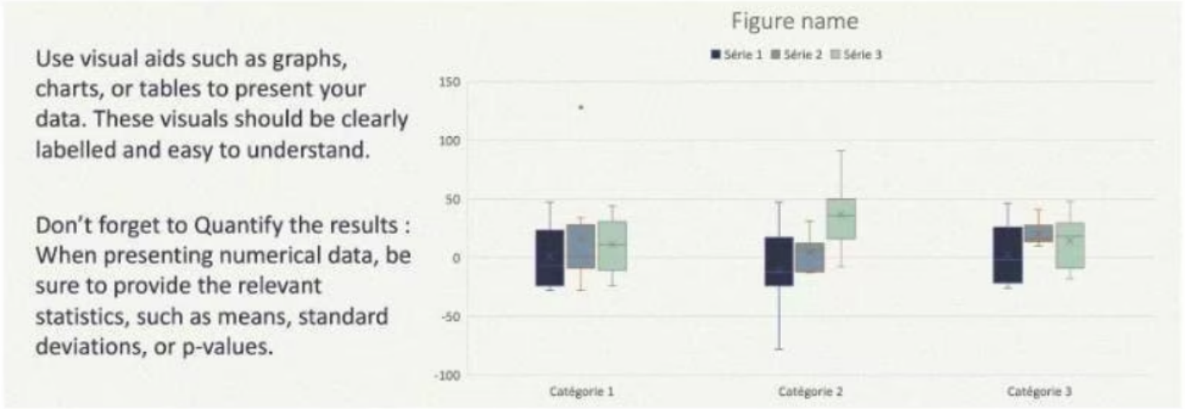



AN EXPLAINABLE ARTIFICIAL INTELLIGENCE FRAMEWORK FOR CLINICAL DECISION SUPPORT SYSTEMS
T. Musah ¹ T. B. Boamah ¹ M. Akpako ¹ P.E Adjei ^{*1}
^{* peadjei.coe@knust.edu.gh}
¹ Department of Computer Engineering, College of Engineering
Kwame Nkrumah University of Science and Technology (KNUST), Ghana
INTRODUCTION
Begin your introduction with a general statement that provides an overview of
your research topic. This statement should help to introduce the topic to the reader and provide some context.
Provide background information: provide some background information on your topic. This could include any relevant history, previous research or developments in the field that have led to your research.
State the problem: Once you have provided some context, state the problem that your research is addressing. This should be a clear and concise statement that outlines the focus of your research.
Explain the significance: After stating the problem, explain why it is significant. Discuss the potential implications of your research and how it could contribute to the field.
Outline the objectives: Finally, outline the objectives of your research. This should be a clear statement of what you are hoping to achieve through your research and should help to guide the reader through the rest of the poster
Fig. 2: Ischemic and Hemorrhagic stokes viewed under NCCT, barely indistinguishable
DISCUSSION
Begin the discussion section by reminding the reader of the main research question and objectives.
Summarize the key findings of your study in a few sentences. Avoid repeating the results section. You are discussing it here.
Discuss the implications of your findings and what they mean in the context of the research question or hypothesis being investigated
Compare with previous research: Compare your findings with those from previous research in the field.
Explain limitations: Discuss the limitations of your study, including any potential sources of error or bias.
Discuss implications and applications: Discuss the implications of your findings for theory and practice in the field.
Explain how your research could be applied in real-world contexts and any potential future research directions.
This box could be a summary of aims/objectives of your study.
Why was the study undertaken? What was the research question, the tested hypothesis, or the purpose of the research?
METHODS
Provide an overview: Begin the methods section with an overview of the experimental design and methods used in your study. This should help the reader understand the overall approach taken in the research. This is a small dummy text where you can elaborate and add some
information about specifics.
This is a small dummy text where you can elaborate and add some
information about specifics.
This is a small dummy text where you can elaborate and add some
information about specifics.
This box could be a summary of the significance of your study. By providing a clear and comprehensive discussion of your results, you can help readers understand the significance of your research and its contribution to the field.
ANY EXTRA WRITING? FIGURES?
Fig. 1: Methodology Example Figure
CONCLUSION
Procedure: Describe the procedures used in your study in detail, including any instructions given to participants or subjects, any specific protocols followed, and any measurements taken.
Data analysis: Finally, provide information on how the data was analyzed, including any statistical methods used and how the data was presented or visualized.
Summary of your key conclusions. Recapitulate the main findings and the implications of the research for theory and practice. It could go along those lines: In conclusion, this study highlights the importance of X in understanding Y and provides a foundation for future research in this area. The findings suggest that X has a significant effect on and that this effect may be mediated by [explain possible mechanisms]. The study has some limitations, but the implications of the findings are significant for clinical practice and public health policy. Overall, this study contributes to the knowledge base in the field and may pave the way for further discoveries.
RESULTS
What answer was found to the research question? What did the study find? Was
the tested hypothesis true? Explains what the authors found following the method previously suggested. You should present your results as objectively as possible.
REFERENCES
Lefteris Benos, Aristotelis C Tagarakis, Georgios Dolias, Remigio Berruto, Dimitrios Kateris, and Dionysis Bochtis. Machine learning in agriculture: A comprehensive updated review. Sensors, 21(11):3758, 2021.
Ania Cravero and Samuel Sepúlveda. Use and adaptations of machine learning in big data—applications in real cases in agriculture. Electronics, 10(5):552, 2021.
Mirza Golam Kibria, Kien Nguyen, Gabriel Porto Villardi, Ou Zhao, Kentaro Ishizu, and Fumihide Kojima. Big data analytics, machine learning, and artificial intelligence in next-generation wireless networks. IEEE access, 6:32328–32338, 2018.
Felix Antonio Rego Rodríguez, Lucía Germán Flores, and AdriánAlejandro Vitón-Castillo. Artificial intelligence and machine learning: present and future applications in health sciences. In Seminars in Medical Writing and Education, volume 1, pages 9–9, 2022.
Claude E. Shannon. A mathematical theory of communication. Bell System Technical Journal, 27(3):379–423, 1948.
mail: compeng@knust.edu.gh
Department of Computer Engineering Technology Week - TWeek 2024
compengknust

